Slide 1
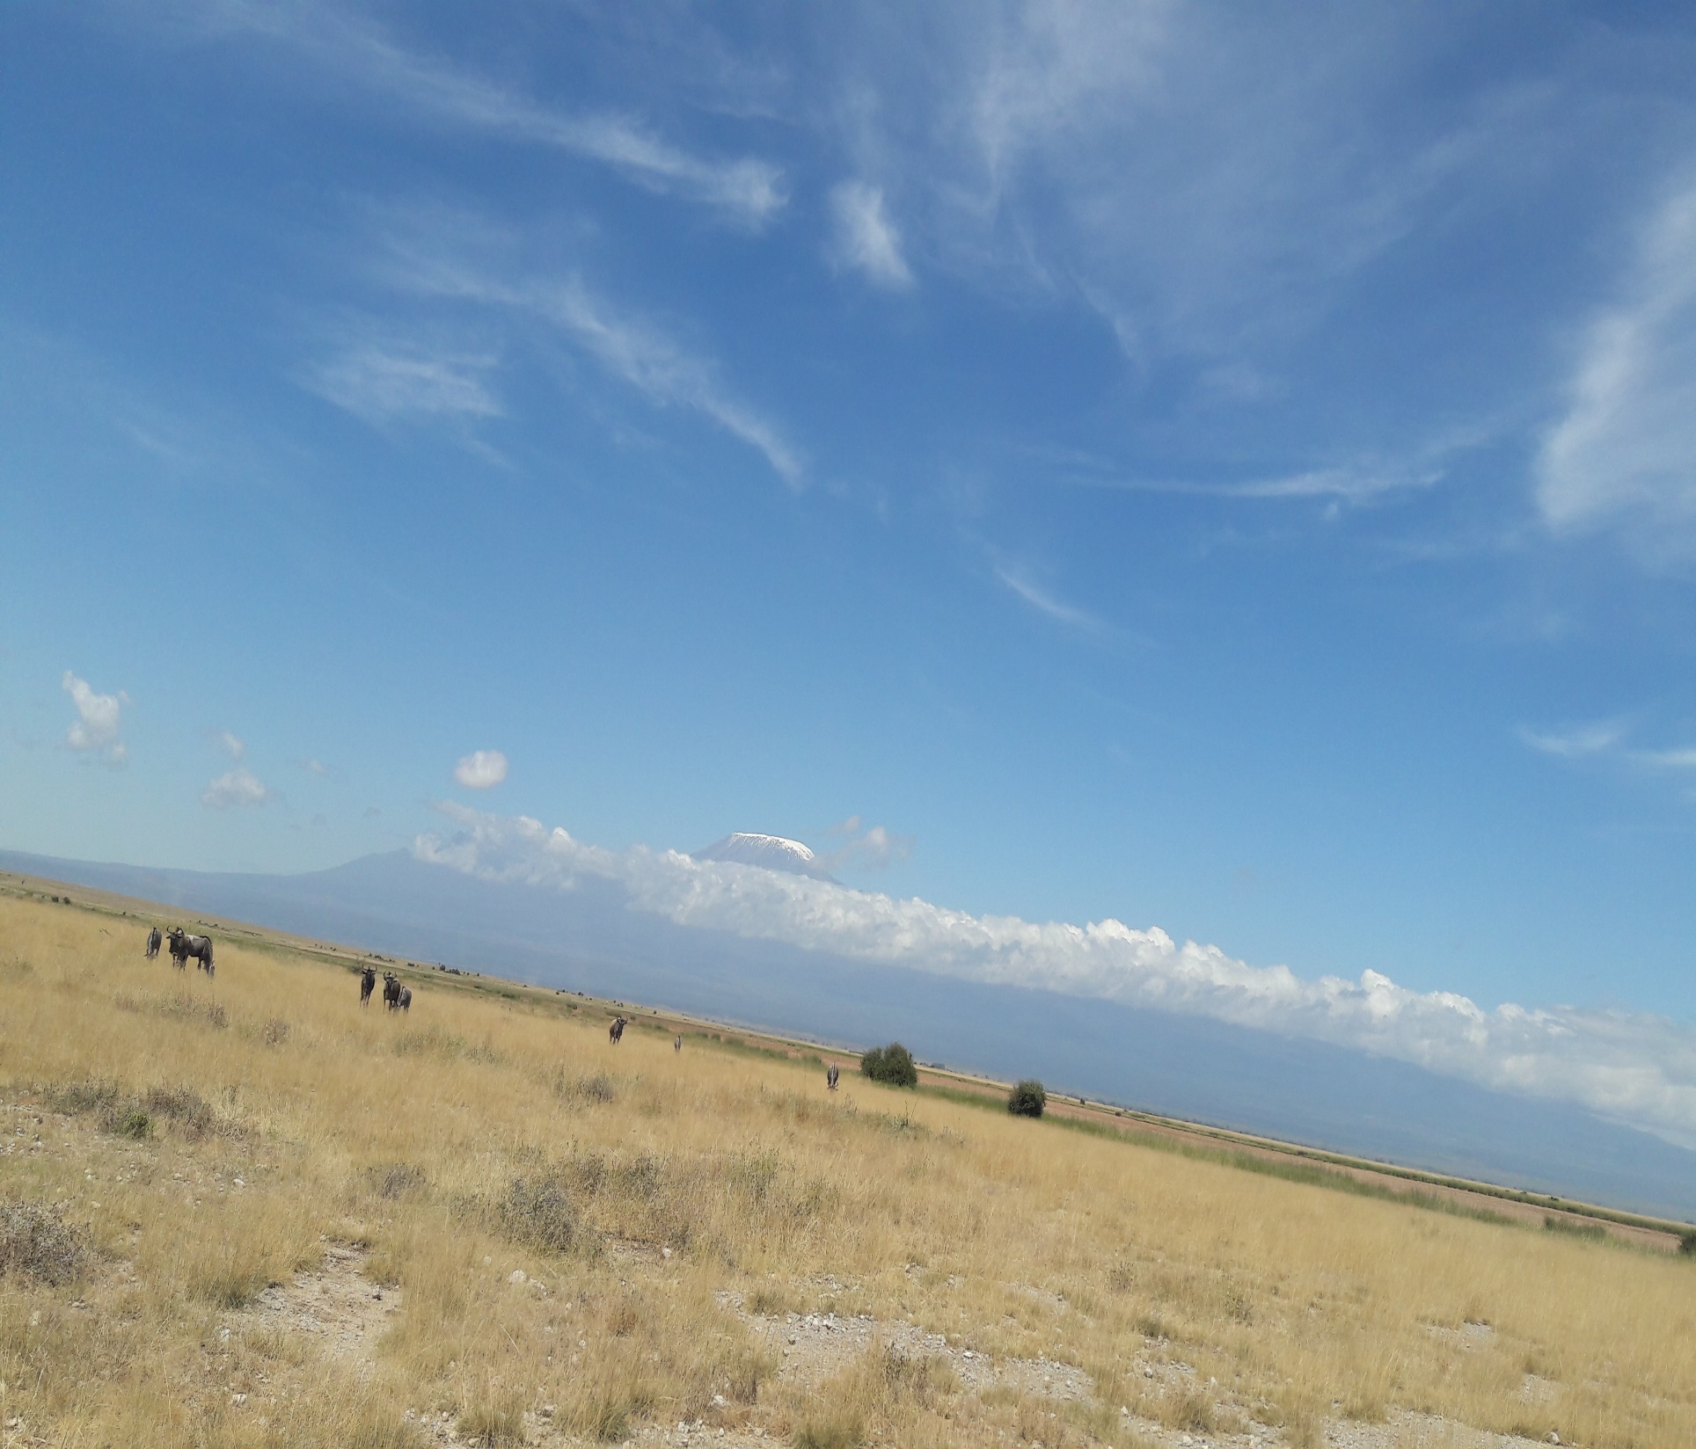
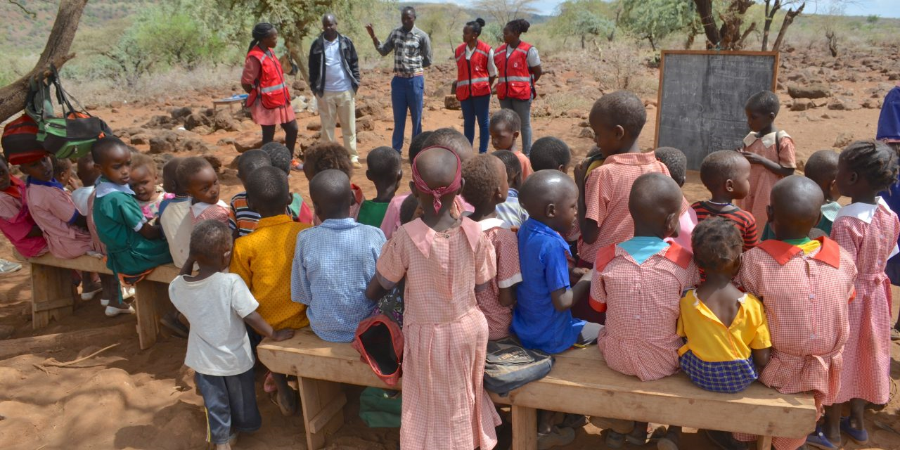
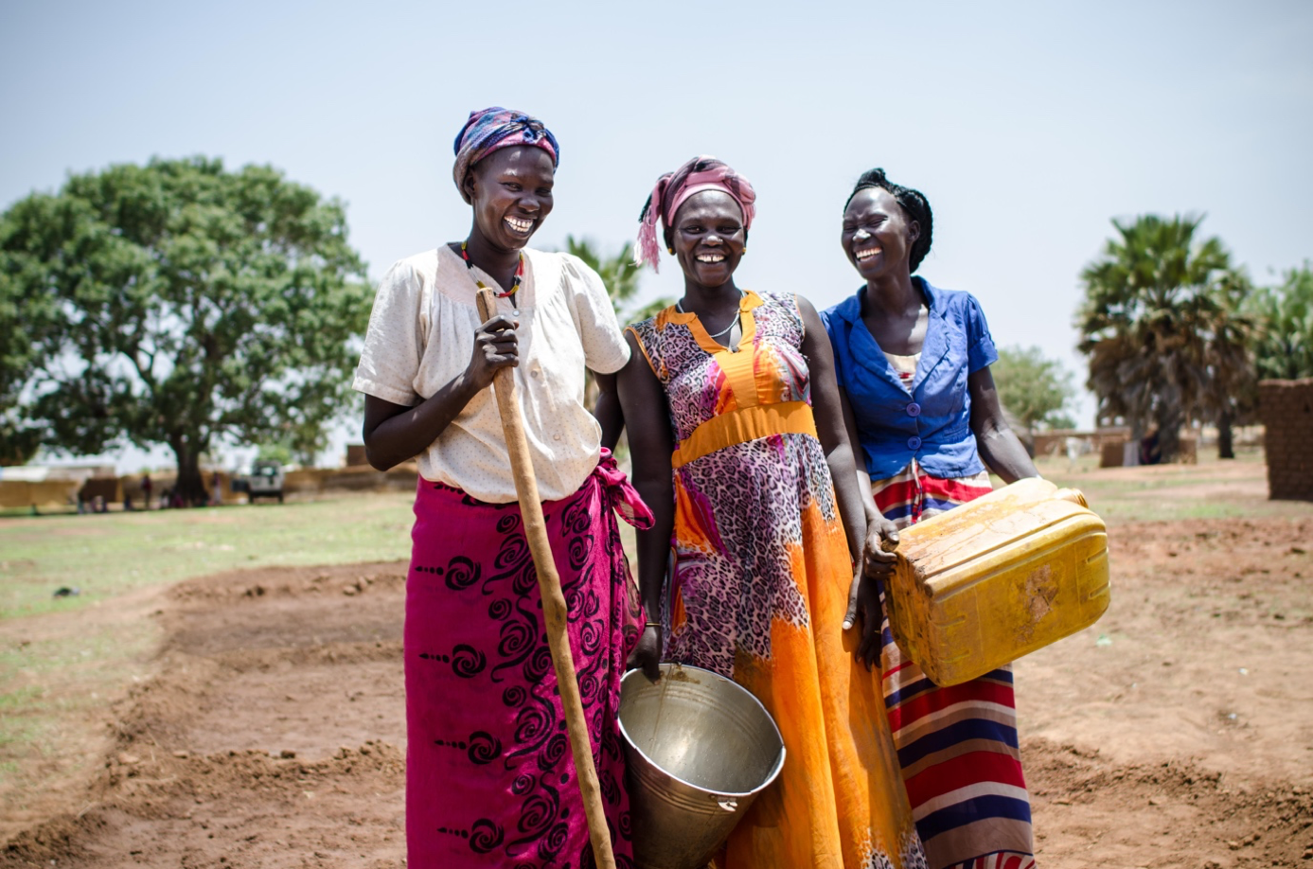
Good Morning ! A warm welcome
ADMAG Face to Face Meeting
5-7 September 2018
Nairobi, Kenya

Slide 2
ADMAG F2F meeting objectives
Update ADMAG’s plan of action and prioritise activities for 2018-2020
Increase our common understanding and commitments to :
Africa Roadmap
Framework for Community Resilience (FCR) in Africa
Surge Optimisation
Preparedness for Effective Response (PER)
Review and validate Disaster & Crisis related HR plan in Africa
Increase collaboration between members and stakeholders

Slide 3
Agenda
Day-1 , Sept 05 , 2018
ADMAG vision, priorities, progress and ToR
Community resilience and climate change adaption in Africa
SMCC for Africa
Protracted crisis and emergencies
Day-2 , Sept 06 , 2018
Sub-regional networks
Surge Optimisation and Preparedness for Effective Response (PER)
Disaster & Crisis related HR plan in Africa
ADMAG priorities for 2018/2019
Day-3, Sept 07 , 2018
External presentation (TBC)
ADMAG priorities for 2018/2019
Way forward and next steps for ADMAG
Side meetings

Slide 4
Housekeeping
Time
Methodology
Shared leadership’s spirit
Opportunity for participation
Communication / translations
Admin–logistics
Safety & security
Parking lot
Feedback
Notes:
Everyone’s been to workshops and conferences and know what the etiquette is, so I’m not going to go over these all. We ask for the standard-
Come on time- we’ll be starting at 8:30 each day and finishing at 5-5:30
Try to minimise side conversations during sessions, keep these to the breaks, lunch etc.
They’ll be tea, coffee and snacks served in the morning before the meeting, during a morning break and in the afternoon break just outside this room here. Lunch will be served at the big Boma, the fancy building just across from here.
If there’s any questions you feel haven’t been answered during the sessions and isn’t on the agenda, then please write it up on the ‘parking lot’ and we’ll try and address this.
Please let us know if we’re hard to understand- I know I have quite a strong accent and not everyone is used to the British accent. Also please, please let me know if there’s any issue with the translations, and translators will let presenters know if they’re speaking too fast

Slide 5
Please let us know your expectations !
Let us know each-other better

